Slide 2
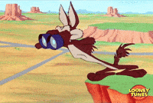
s
er
ch
s
ear
ch
搜查；搜尋

Slide 3
w
or
d
or
單字

Slide 4
word
search

Slide 5
Tony
110
31

Slide 6
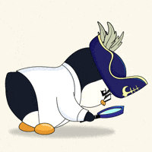
search
ing
I am searching.

Slide 7
f
i
nd
找到，尋得；發現

Slide 8
I can’t find it.

Slide 9
f
ou
nd
find的動詞過去式、過去分詞

Slide 10
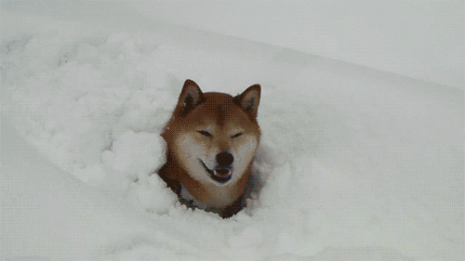
I found it.

Slide 12
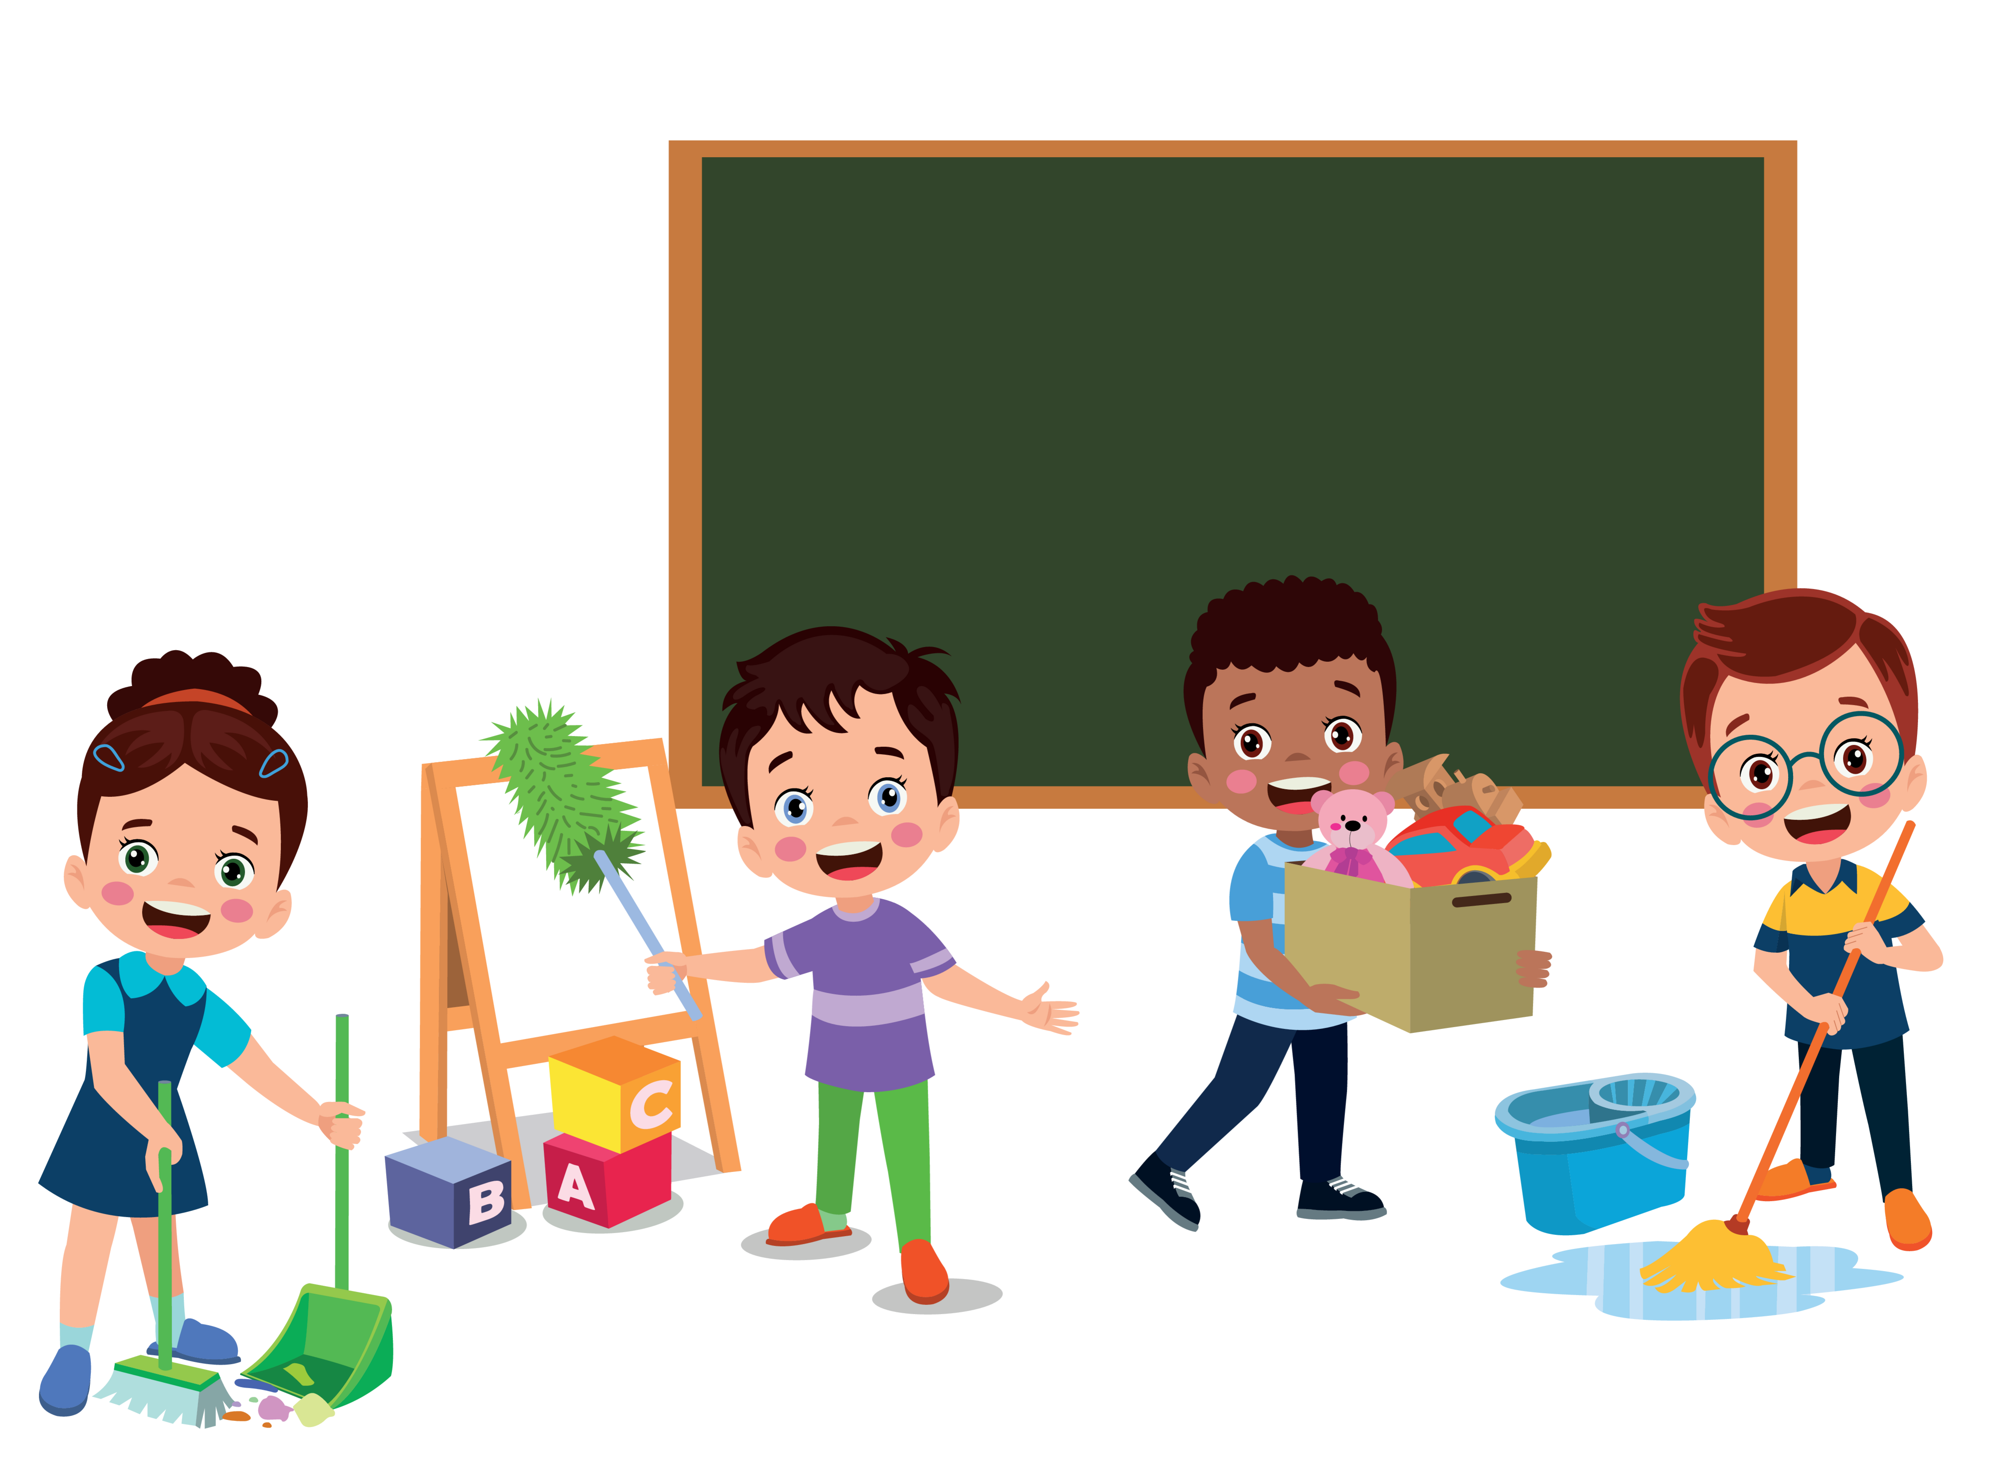
Let’s clean the classroom.

Slide 13
There …
有，擁有
… there.
在那裡；到那裡；向那裡
（表示滿意，得意，鼓勵，安慰，挑釁等）你瞧；好啦；喂
There, there. Stop crying. 好啦，好啦，別哭了。

Slide 14
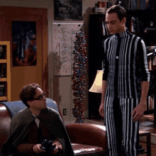

Slide 15
h
a
ng
懸掛，吊著

Slide 16
h
a
ng
i
n
堅持不懈

Slide 17
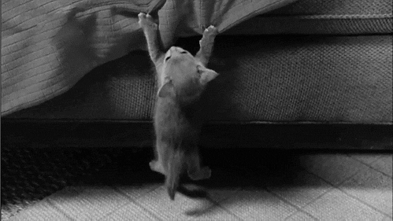
Hang in there.
堅持住。
頂住！
不要放棄。

Slide 18


Slide 19
Ok. But what do we clean?

Slide 20
There are many
things to clean.

Slide 21
…and many things to do.

Slide 22
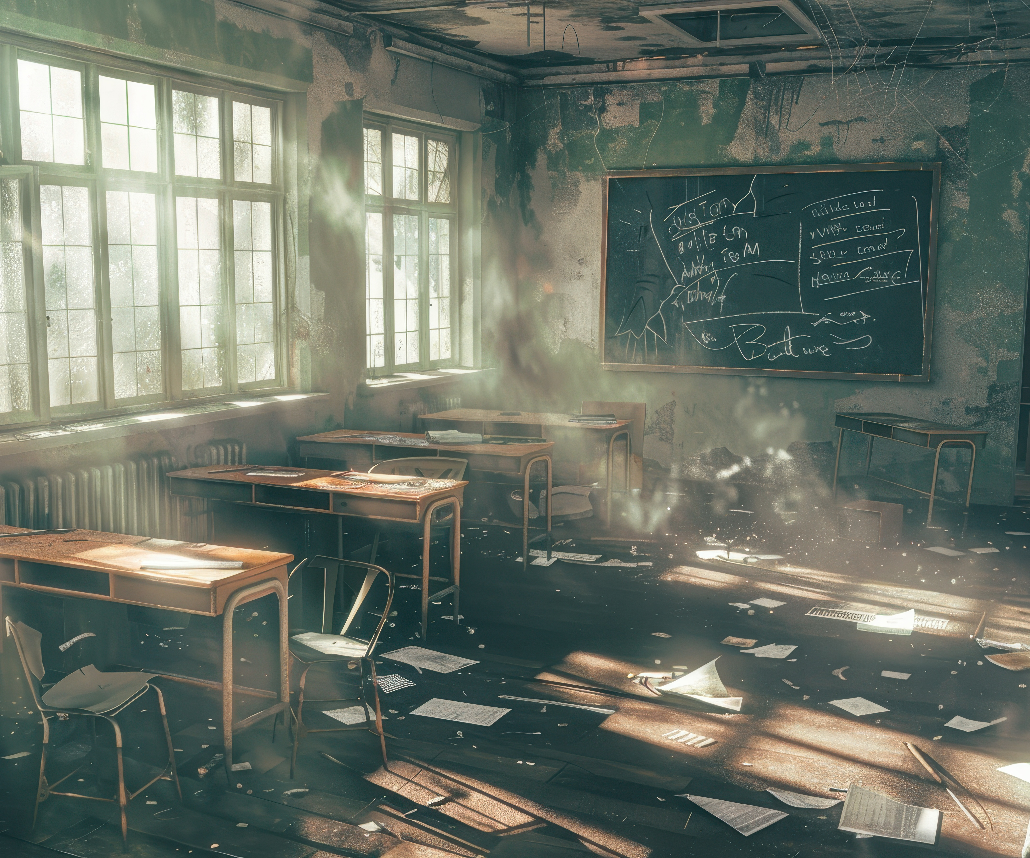

Clean the classroom.

Slide 23
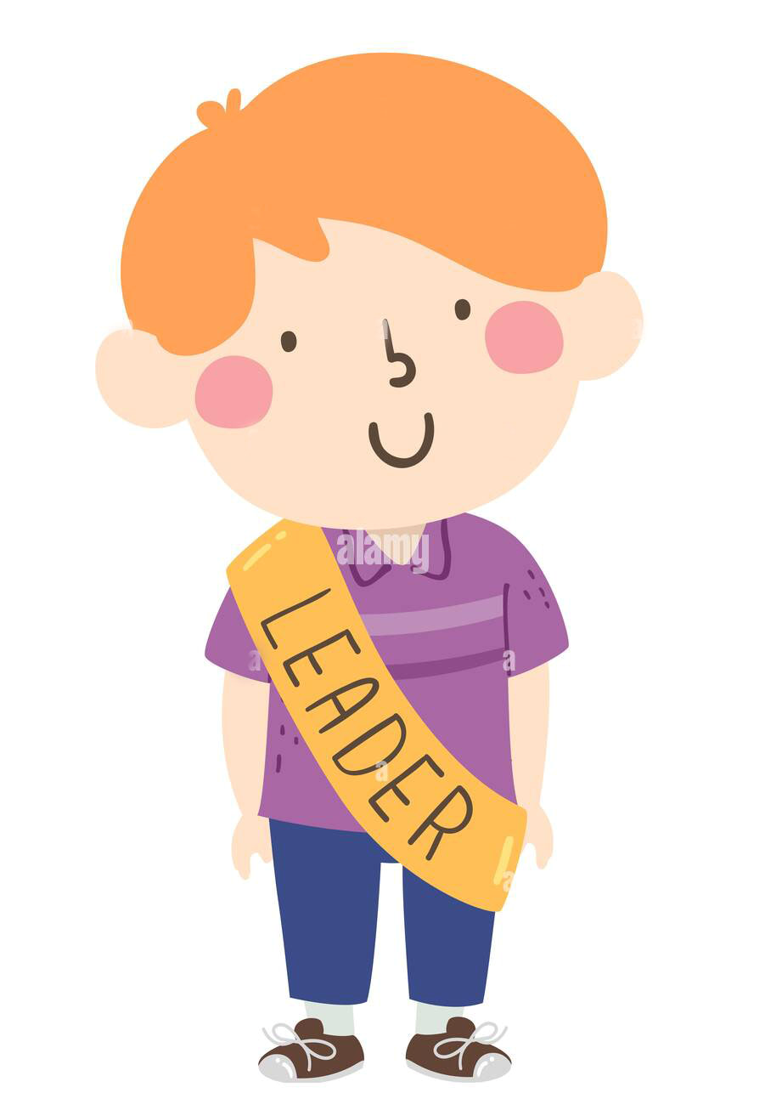
Ok. Clean what?

Slide 24

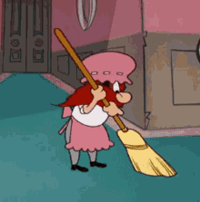

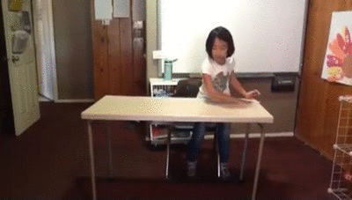
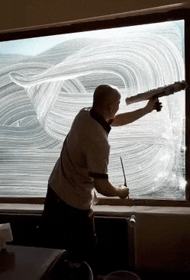
1. Sweep (the floor).
2. Mop (the floor).
3. clean the desks
4. clean the windows

Slide 25
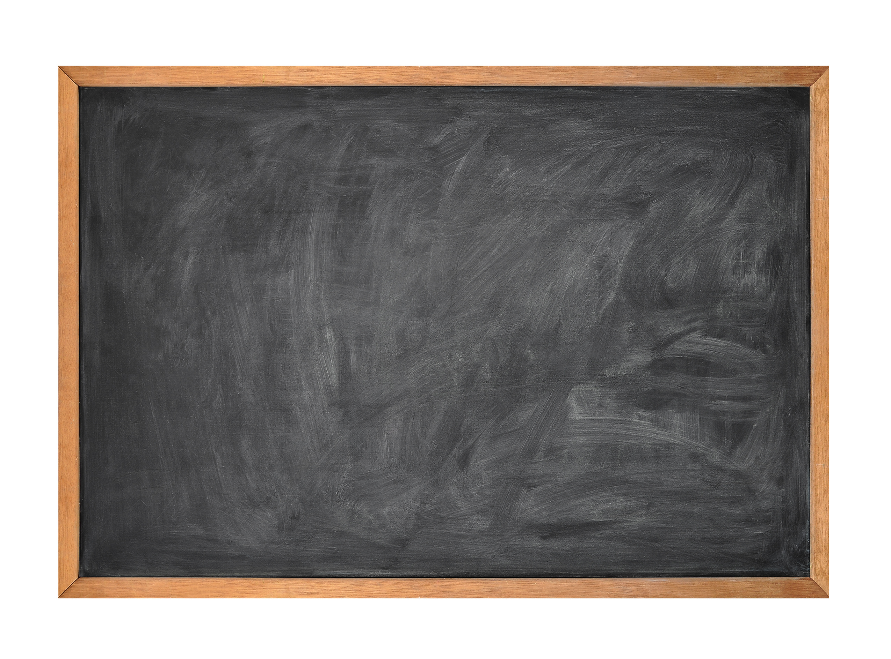
black
b
oa
r
d

Slide 26
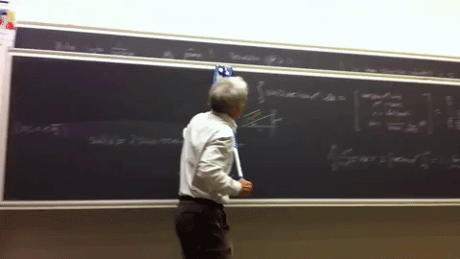
5. Clean the blackboard.

Slide 27
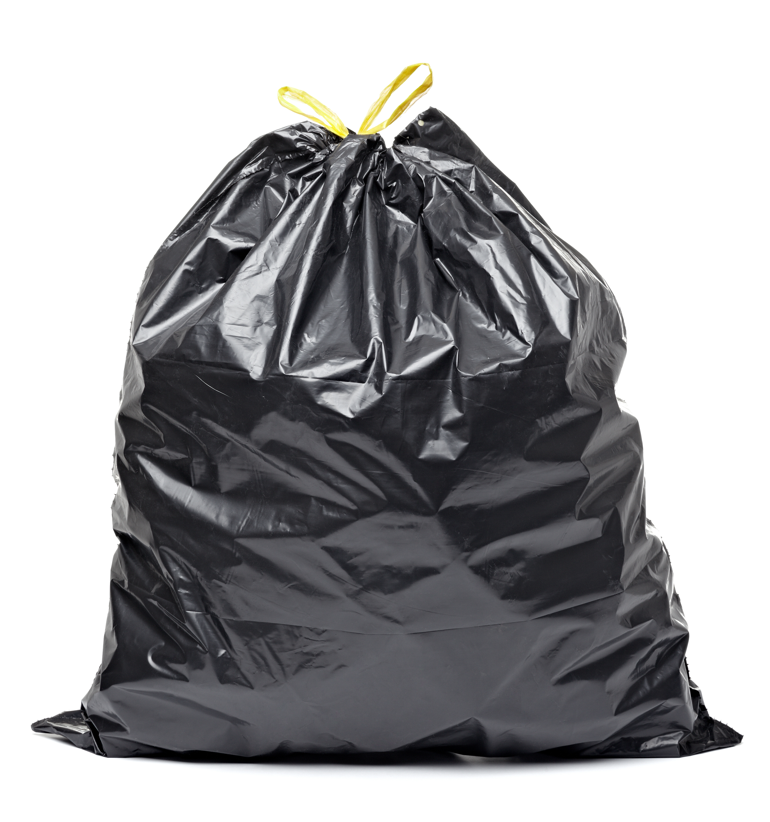
t
r
a
sh

Slide 28
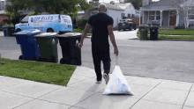
5. Clean the blackboard.
6. Take out the trash.

Slide 29
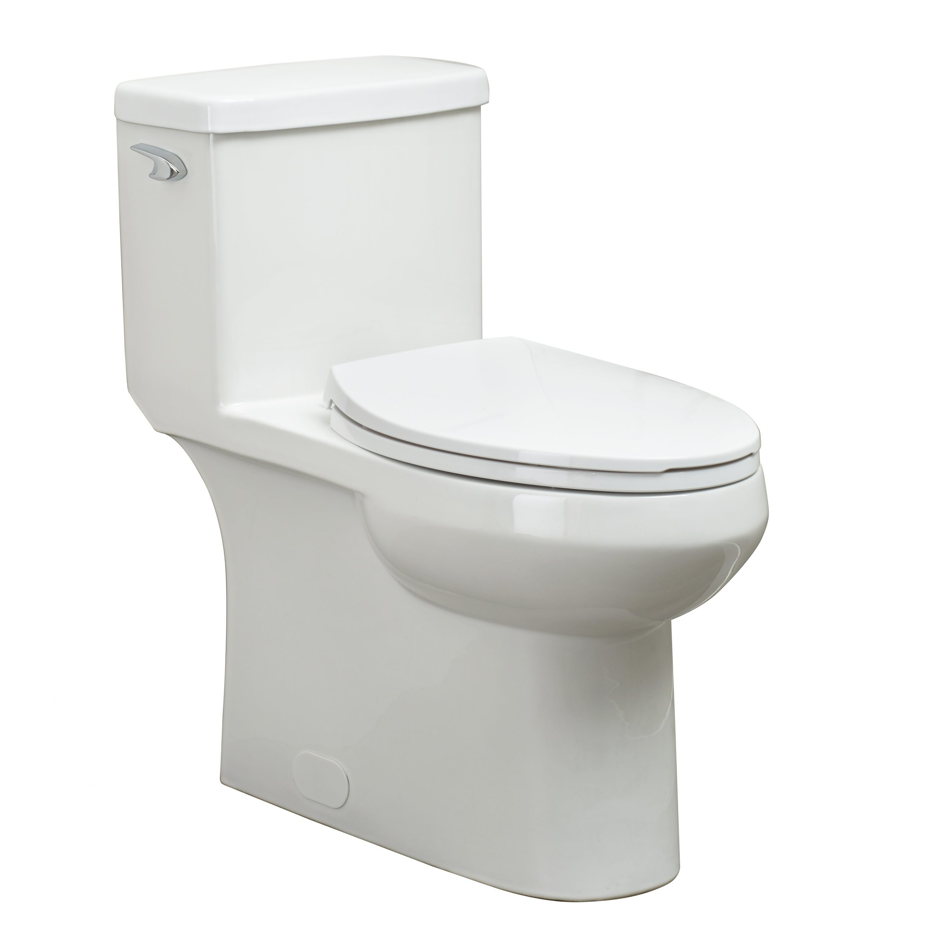
t
oi
l
et

Slide 30
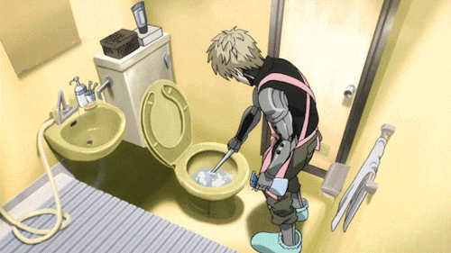
5. Clean the blackboard.
6. Take out the trash.
7. Clean the toilets.

Slide 31
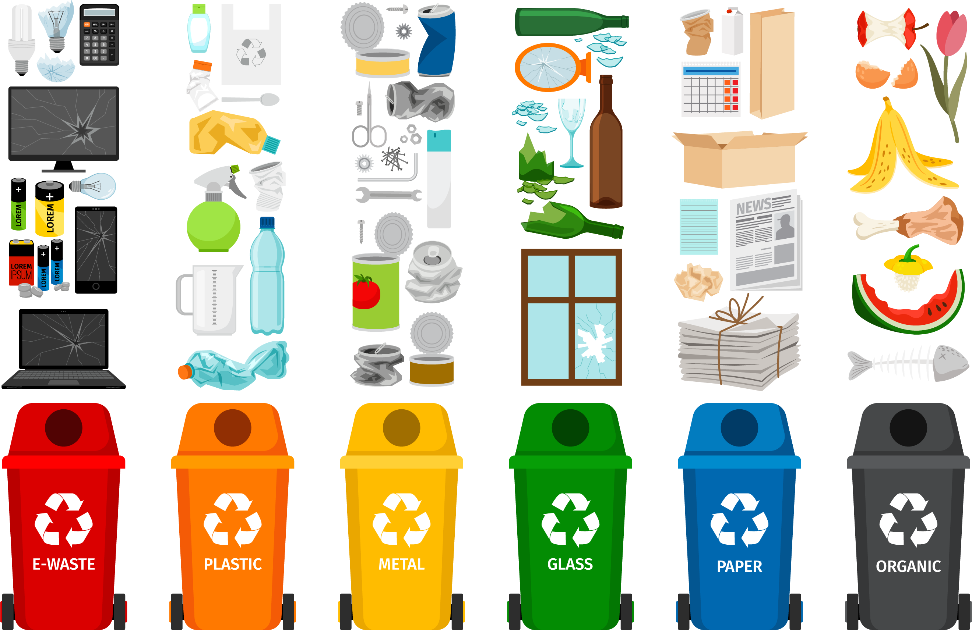
re
cy
c
l
ing

Slide 32
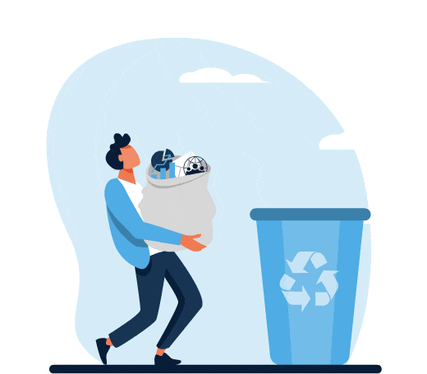
5. Clean the blackboard.
6. Take out the trash.
7. Clean toilets.
8. Take out the recycling.

Slide 33
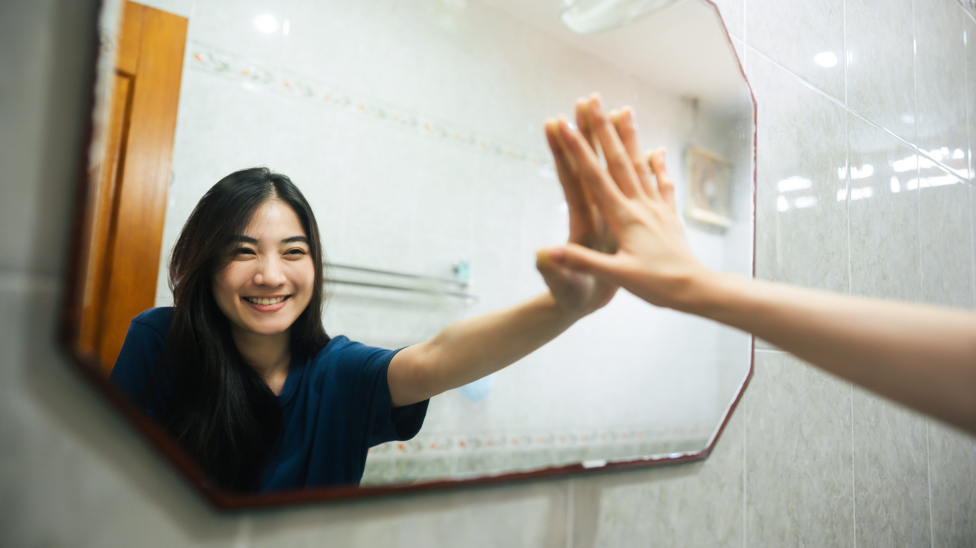

Slide 34
What are you?
What do you do?
I am a (what).
I (動詞).
What do you do?
What can you do?
I am a (what).
I can (動詞).
What do you like?
What do you want?
I like … (what).
I want … (what).

Slide 35
Who

Slide 36
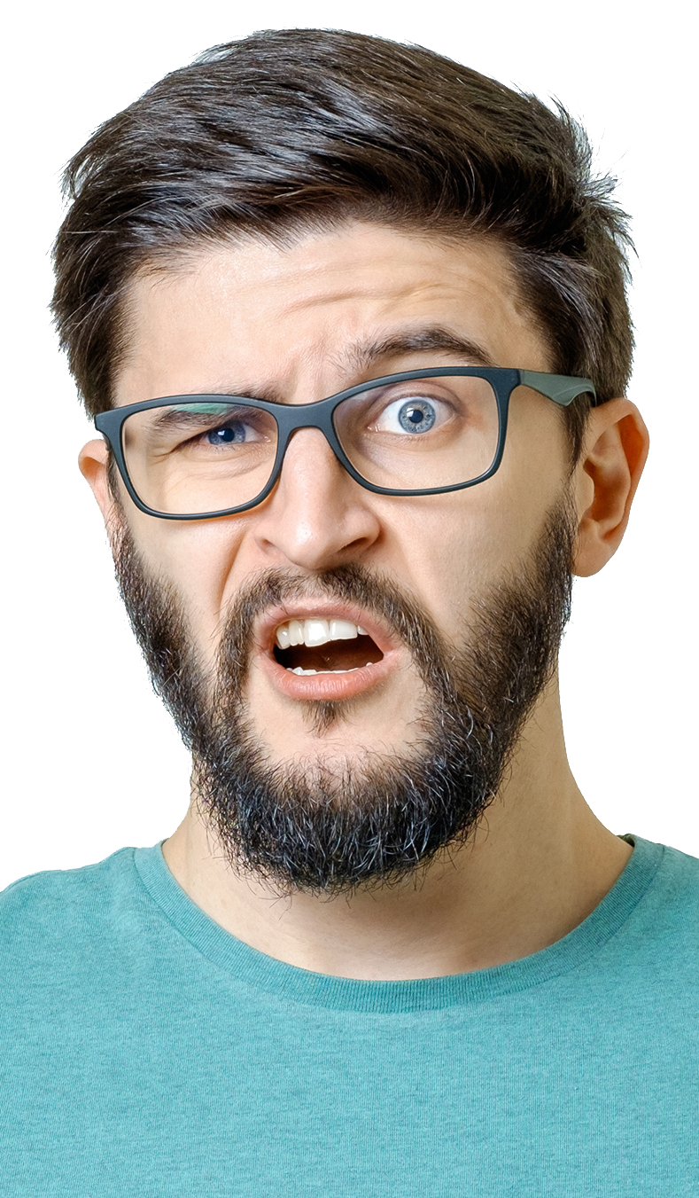
Who can take out the trash?

Slide 38


I can.

Slide 39
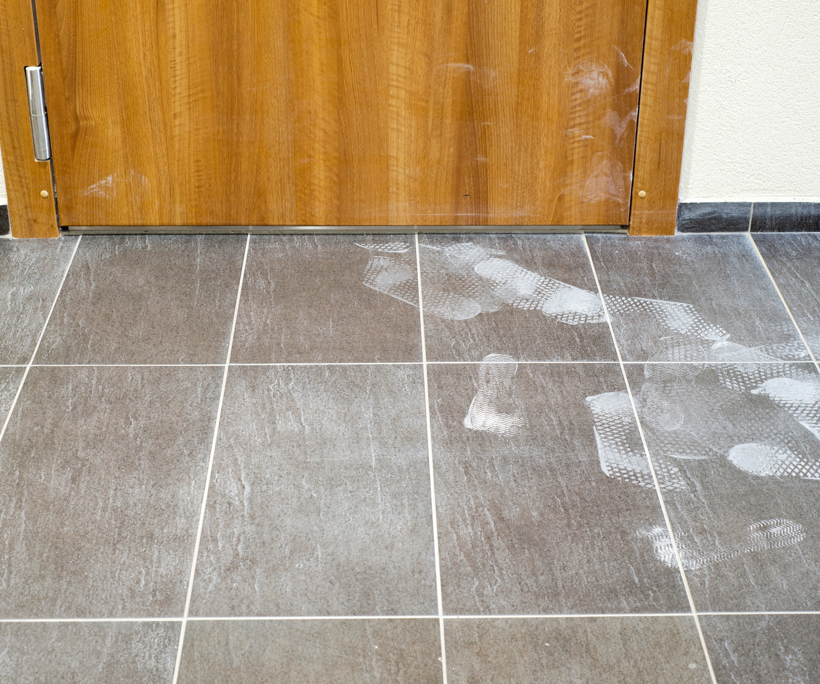
Who can clean the floor?

Slide 40
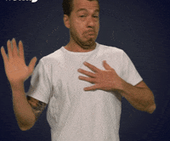
I can’t.

Slide 41
Whose
誰的

Slide 42
du
ty
責任；義務；本分
c
h
o e
r
j
o
b
家庭雜務；農莊雜務；
日常零星活兒，例行工作
工作；職業；零工； 分內事，職責

Slide 43
Whose duty is it?

Slide 44
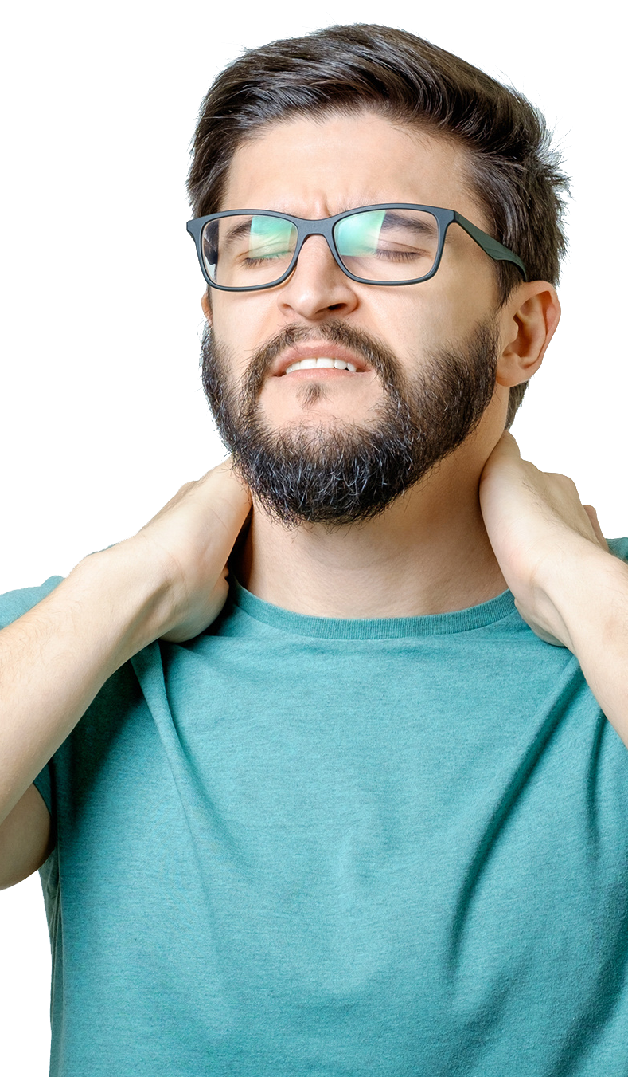
Not mine!

Slide 45

Not my duty!

Slide 46
Whose chore is it?

Slide 47
Not mine!

Slide 48
Not my chore!

Slide 49
Whose job is it?

Slide 50
Not mine!

Slide 51
Not my job!

Slide 52
It is mine.

Slide 53
It is my job.

Slide 55
du
ty
責任；義務；本分
c
h
o e
r
j
o
b
家庭雜務；農莊雜務；
日常零星活兒，例行工作
工作；職業；零工； 分內事，職責

Slide 56
To
ny
re
s
p
on
sib
bil
lit
ty
re
spon
sib
bil
lit
ty

Slide 57
responsibility
責任

Slide 58
What are your responsibilities?
Our responsibilities are …
1.
2.

